Slide 1

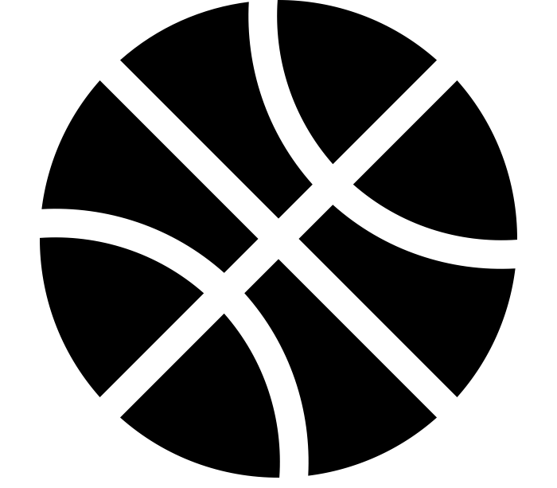
TASK
MADNESS
ON DEMAND
PROCESSING WITH
SPRING CLOUD TASK
TASK MADNESS
ON DEMAND PROCESSING WITH SCT
Notes:
https://www.flickr.com/photos/tabor-roeder/16811793545/

Slide 2

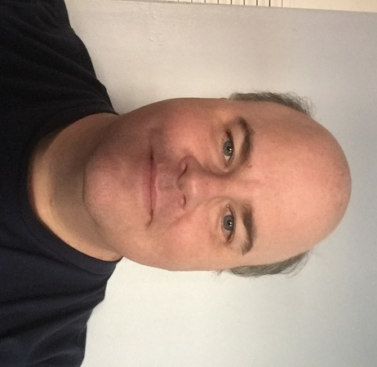
WHO ARE WE?
MICHAEL MINELLA
@michaelminella
@OffHeap
Github: mminella
https://www.spring.io
GLENN RENFRO
@cppwfs
Github: cppwfs
https://www.spring.io

Slide 3
Pivotal is hiring

Slide 4
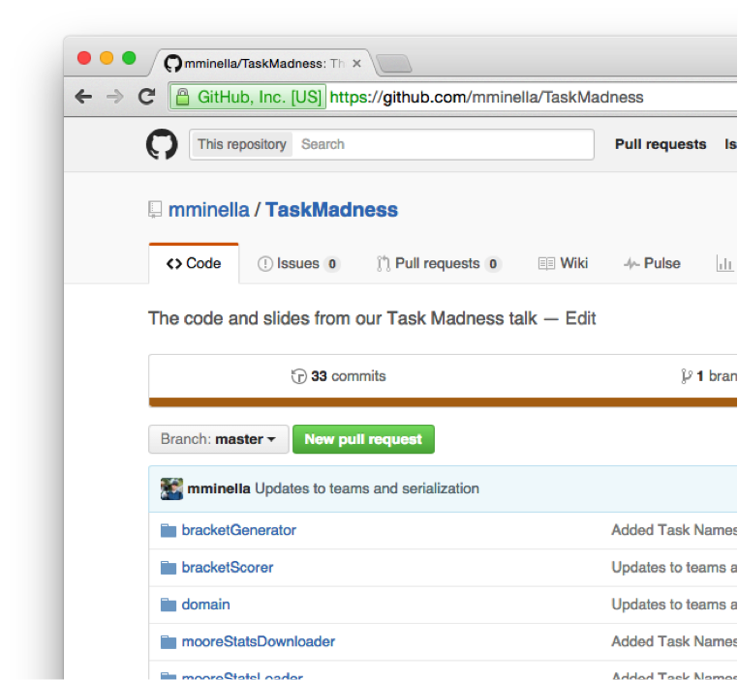

CODE IS ON GITHUB
https://github.com/mminella/TaskMadness

Slide 5


QUICK
POLL

Slide 6
NCAA Tournament

Slide 7
Infographic for stats on the tournement

Slide 8
About the tournament

Slide 9
Single elimination

Slide 10
64 teams

Slide 11
Teams are seeded

Slide 12
Gambling is based on choosing a bracket

Slide 13
Not that hard right?

Slide 14
9 Quintillion possible combinations

Slide 15
Warren Buffet offered 1 billion dollars for a perfect bracket in 2014

Slide 16
ESPN Scoring Rules

Slide 17
What qualifies as a “good bracket”?

Slide 18
2015 Not that crazy of a year
Notes:
3 #1 seeds made the final 4
A #7 seed was the other (that was the “odd” part).
#1 seed (Duke) won

Slide 19
A perfect bracket is 1920
Notes:
320 per round * 6 rounds

Slide 20
Winner scored 1830

Slide 21
Joe Lunardi scored 760 in 2015 and 600 in 2014
Notes:
http://games.espn.go.com/tournament-challenge-bracket/2015/en/entry?entryID=4607369

Slide 22
To crack the top 100 out of the 11 million brackets submitted, you needed 1760
Notes:
2014, a much crazier year…The winner had 1730 and to break the top 100, you needed a 1520

Slide 23
However scores typically have a pretty tight bell curve

Slide 24
We aren’t looking for a perfect bracket

Slide 25
Just one better than everyone else in the office

Slide 26
How are we going to do that?

Slide 27
Use a model to generate millions of brackets

Slide 28
Filter statistically unlikely scenarios out

Slide 29
Score remaining brackets based on other input

Slide 30
Top bracket is “our bracket”

Slide 31
How do we implement this?

Slide 32
Spring Batch!

Slide 33
Not ideal

Slide 34
Different components execute at different times

Slide 35
Different steps should be decoupled

Slide 36
Orchestration should live at a higher level

Slide 37
Distributed deployment options

Slide 38
Develop each component as a microservice

Slide 39
Obey the 12 factor app principals

Slide 40
Just short lived

Slide 41
Introducing Spring Cloud Task

Slide 42
A framework for providing functional and nonfunctional features
for building short lived microservices.

Slide 43
Currently M1

Slide 44
Hello World of Spring Cloud Task

Slide 45
Orchestrating multiple tasks

Slide 46
Image walking through our architecture

Slide 47
Demo

Slide 48
Code!

Slide 49
Roadmap

Slide 50
Spring Cloud Stream integration

Slide 51
Batch integration

Slide 52
Orchestration via Spring Cloud Data Flow
Notes:
Call out tasks replace jobs in SCDF from XD

Slide 53
M2 early next month

Slide 54
GA early Q2

Slide 55
Questions?

Slide 56
Thanks!

Slide 58
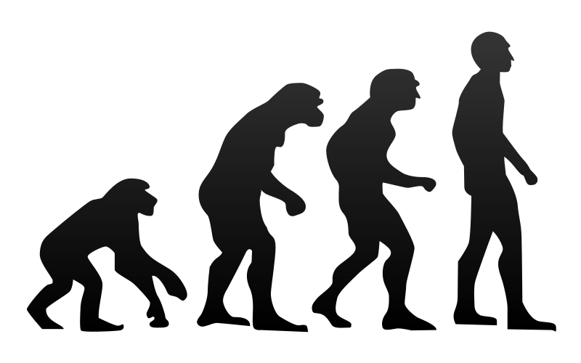

EVOLUTION OF DATA
APPLICATIONS
Notes:
Integration/batch

Slide 59

MONOLITHS
Notes:
Tight coupling between data models and business logic
Operationally hard to deploy/troubleshoot/etc
Delayed time to market

Slide 60



EXISTING
INTEGRATION AND BATCH

Slide 61


DATA
MICROSERVICES

Slide 62


CLOUD
NATIVE

Slide 63

DEVELOPED AND TESTED
IN ISOLATION

Slide 64

OPERATIONALLY EASY TO
GOVERN

Slide 65

DATA INTEGRATION
AS A SERVICE

Slide 66

COMPOSTION OF
MICROSERVICES

Slide 67
<?xml version="1.0" encoding="UTF-8"?> <beans xmlns="http://www.springframework.org/schema/beans" xmlns:xsi="http://www.w3.org/2001/XMLSchema-instance" xsi:schemaLocation="http://www.springframework.org/schema/batch http://www.springframework.org/schema/batch/spring-batch.xsd http://www.springframework.org/schema/beans http://www.springframework.org/schema/beans/spring-beans.xsd"> <job id="ioSampleJob" xmlns="http://www.springframework.org/schema/batch"> <step id="step1"> <tasklet> <chunk reader="itemReader" processor="itemProcessor" writer="itemWriter" commit-interval="2" /> </tasklet> </step> </job> <bean id="itemProcessor" class="org.springframework.batch.sample.domain.trade.internal.CustomerCreditIncreaseProcessor" /> </beans>
ZERO CODING

Slide 68
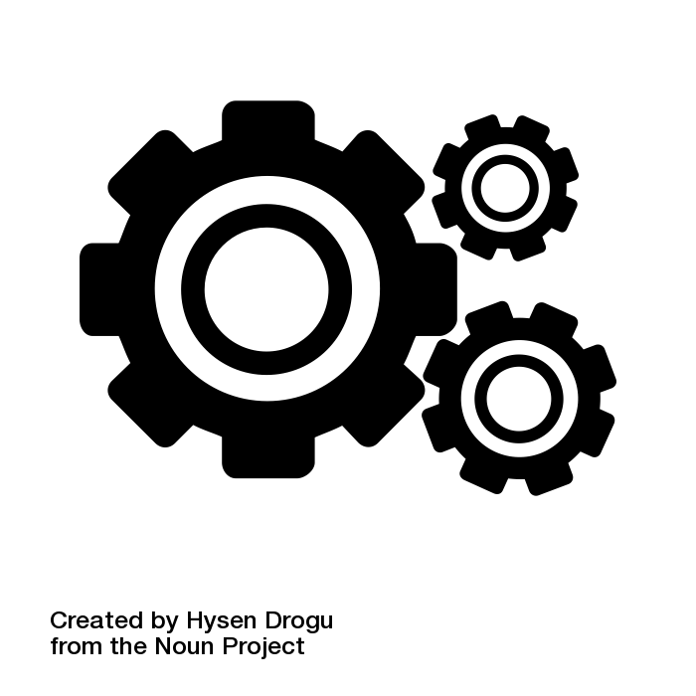
OPERATIONAL AND
ORCHESTRATION COVERAGE

Slide 69

SPRING XD
EXTREME DATA

Slide 70


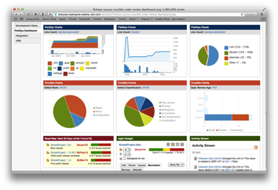





Ingestion
Orchestration
SPRING
Extraction
Real-time
Analytics
Notes:
Spring XD handles everything in the circle

Slide 71

DISTRIBUTED
RUNTIME

Slide 72
&
STREAMING
BATCH

Slide 73
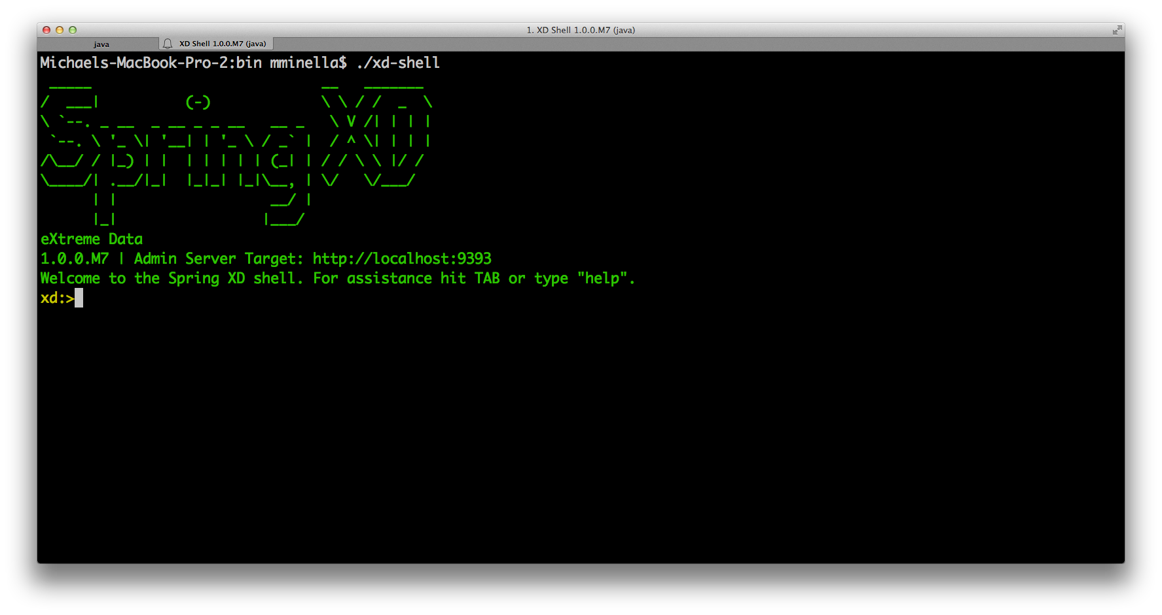

Slide 74
// Ingestion Stream Definitions
http | filter | acmeenrich | shell | hdfs

Slide 75
// Tap Definitions
IoT-HTTP.shell > typeconversiontransformer |
gemfire-server

Slide 76
SPRING CLOUD
DATA FLOW

Slide 77
SPRING XD
VERSION 2.0

Slide 78

SPRING CLOUD
STREAM
SPRING CLOUD
TASK

Slide 79

DECOMPOSE INTO BOOT
MICROSERVICES

Slide 80
SPRING CLOUD STREAM
HANDLES MESSAGING

Slide 81
SPRING CLOUD TASK
HANDLES STATE

Slide 82

Notes:
Introductions

Slide 83
BATCH ON
CLOUDFOUNDRY

Slide 84
A BRIEF INTRO
TO BATCH

Slide 85

Batch processing, … is defined as the
processing of a finite amount of data
without interaction or interruption.

Slide 86
1
REPORT GENERATION

Slide 87
2
ETL PROCESSING

Slide 88
3
DATA SCIENCE

Slide 89
4
BIG DATA
Notes:
INGEST
EXTRACT
ORCHESTRATION

Slide 90
Step1
Step2
Step3
ItemReader
Tasklet
ItemReader
ItemProcessor
ItemProcessor
ItemWriter
ItemWriter

Slide 91
CHALLENGES OF
BATCH ON CLOUDFOUNDRY

Slide 92
WHERE DO I
GET MY DATA?

Slide 93
1
SERVICES FOR REMOTE

Slide 94
2
GET IT WHEN YOU NEED IT

Slide 95
HOW DO I
ORCHESTRATE MY JOBS?

Slide 96

TODAY

Slide 97

THE FUTURE

Slide 98
SPRING CLOUD
DATA FLOW

Slide 99

WARS AND
APP SERVERS

Slide 100
DECOMPOSE INTO BOOT
MICROSERVICES

Slide 101
SPRING CLOUD
STREAMS

Slide 102
SPRING CLOUD
DATA FLOW

Slide 103
Data Integration as a Service
Traditional Apps
Data Microservices
Existing Enterprise SI/SB
Existing SI/SB workload dissected into distributed cloud native spring boot apps
A scalable service for real-time stream and batch based data pipelines.
Tight coupling between data models and business domains
Operationally hard to deploy, scale, troubleshoot, or monitor
Delays time to market
Develop, test, and deploy in isolation
Apply modern microservices patterns including composition and messaging
Operationally easy to govern
Streams or jobs as compositions of message driven microservices
Declaritive DSL to create data-centric pipelines; zero coding for common use-cases
Complete operational and orchestration coverage

Slide 104


Slide 105

Learn More. Stay Connected.
Pivotal: pivotal.io
Twitter: twitter.com/springcentral
YouTube: spring.io/video
LinkedIn: spring.io/linkedin
Google Plus: spring.io/gplus
Spring Cloud Streams
Project: spring.io/spring-cloud
Github: github.com/spring-cloud/spring-cloud-streams
Jira: jira.spring.io/browse/XD
Spring Boot
Project: spring.io/spring-boot
Github: github.com/spring-projects/spring-boot
Spring XD
Project: spring.io/spring-xd
Github: github.com/spring-projects/spring-xd
Jira: jira.spring.io/browse/XD

Slide 106







Notes:
https://commons.wikimedia.org/wiki/File:Human_evolution.svg

Slide 107

The
End

Slide 108
